Slide 1

Bitwarden Password Manager
Brandon Nowak, Ivan Geter, Lexis Lewis, Oscar Sheffera
Notes:
Brandon:
Welcome, we’re group one. My name is Brandon, presenting Bitwarden password manager with Ivan, Lexis, and Oscar.

Slide 2
Why Bitwarden (Technical Background)
Catastrophic LastPass breach indicates need for reliable open-source online password manager.
Open-source code that can be accessed at https://github.com/bitwarden
Zero-knowledge encryption.
AES-CBC 256-bit encryption for vault data, PBKDF2 SHA-256 (Argon2) to derive encryption key.
Bitwarden servers are ONLY used for storing encrypted data (NOT multi-use).
Vault data can ONLY be decrypted using the key derived from your master password.
2FA: (authenticator, email, Yubikey)
Emergency Access (premium)- pre-determined, trusted emergency contacts can request and obtain access to your vault.
Available for Windows, Mac, Linux, Android, iPhone.
Browser extensions for Chrome, Safari, Firefox, Vivaldi, Opera, Brave, Edge, Tor, DuckDuckGo.
Can be accessed via CLI or GUI.
Individual, Family, and Enterprise options.
Notes:
Brandon:
Last Pass breach- August ‘22 to March ‘23 drip fed details about the breach series often contradicting what they said prior ranging from bad to worse. Closed source code was ultimately compromised due to poor remote working security practices, privilege escalation, and persistence.
https://www.itpro.co.uk/security/information-security-infosec/370210/lastpass-breach-last-chance
We picked Bitwarden due to its open-source code that is highly scrutinized by the public (can be viewed on GITHUB) and maintained by well-respected members of the cybersecurity community, maintain the most up-to-date advanced encryption standards, dedicated servers, and zero-knowledge encryption policy.
Bitwarden as a company cannot see your passwords, they remain encrypted end-to-end with your individual email and Master Password- never store and cannot access your Master Password.
Emergency Access for trusted emergency contacts and NOK.
Available across virtually all OS and Browser extensions.
Free, Premium, and Enterprise options so use can be scaled to any individual or group.

Slide 3
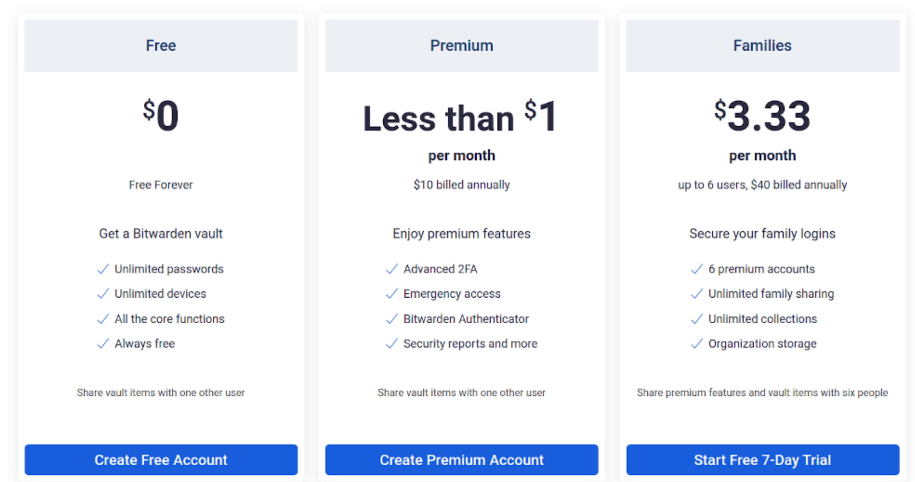
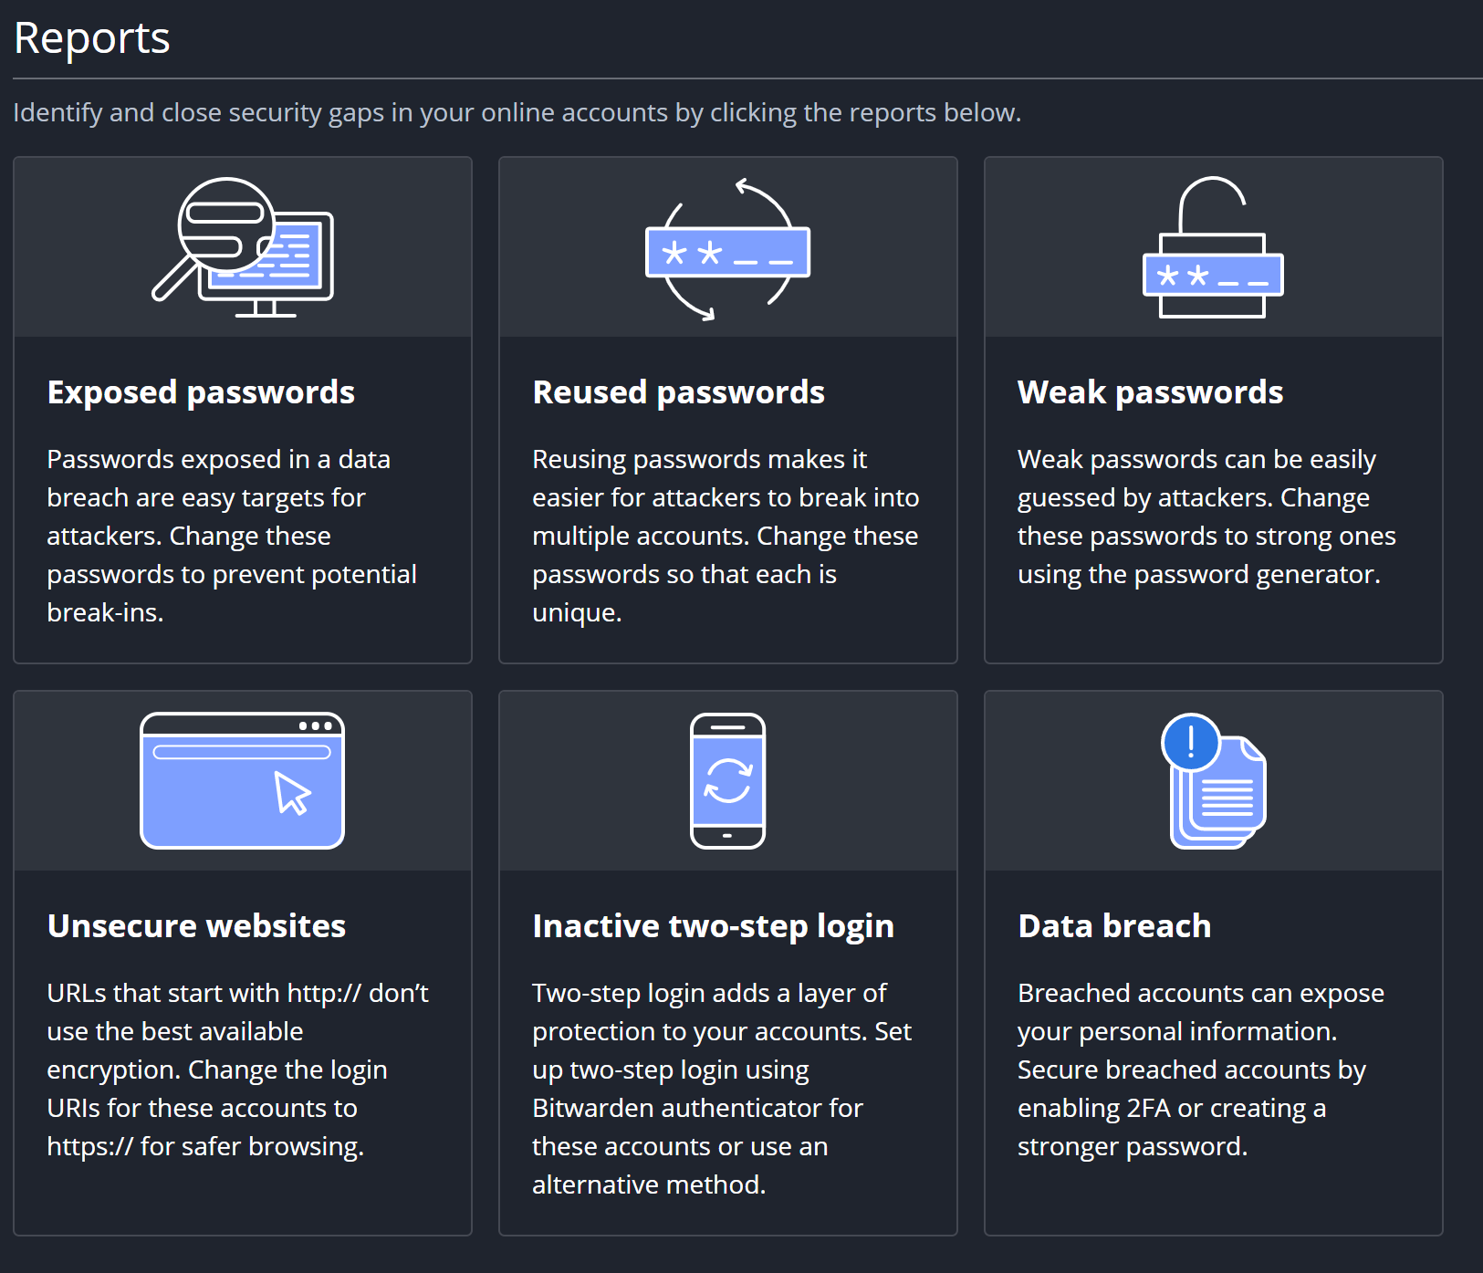
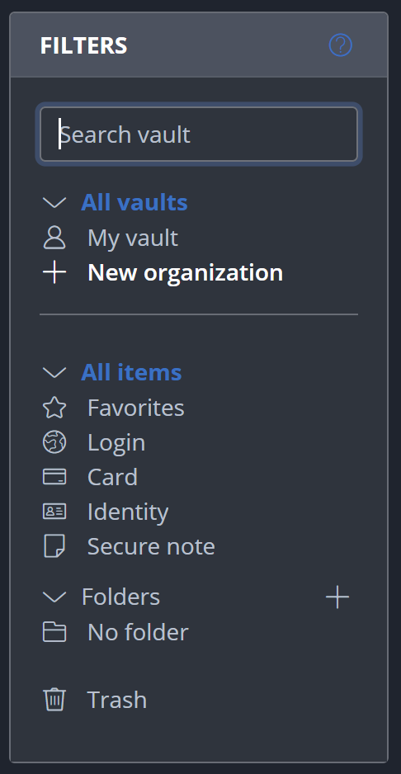
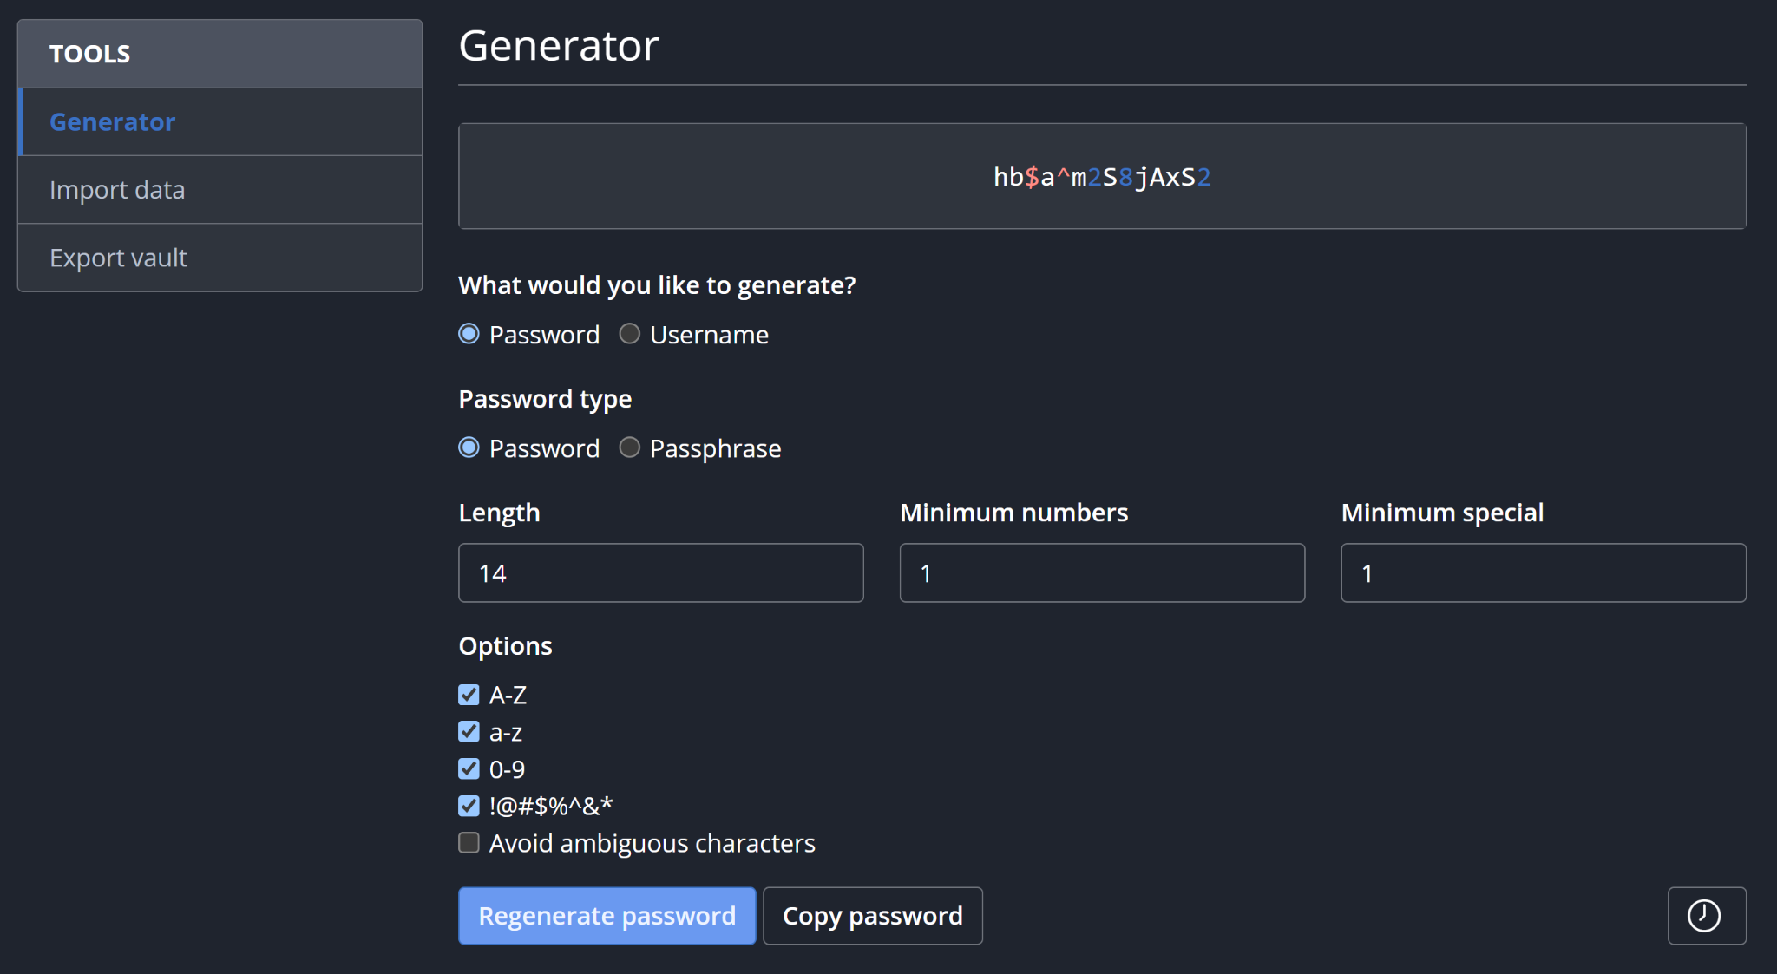
Features at a glance
Notes:
Lexis
Bitwarden is a feature-rich password manager that enables users to securely store, manage, and share their passwords and other sensitive data. Its key features include a password generator, autofill, secure sharing,, secure notes, multi-platform support, cloud sync, and encrypted storage.
Password Generator: Bitwarden allows users to generate strong, unique passwords for their accounts, reducing the risk of data breaches.
Autofill: The Bitwarden browser extension and mobile app can automatically fill in login credentials
saving users time and reducing the risk of typing errors.
Secure Sharing: securely share passwords and other sensitive information with trusted individuals or teams.
Secure Notes: Allows users to store and manage various types of sensitive information, such as credit card numbers, secure notes, and identity documents.
Multi-Platform Support: It is available as a browser extension, desktop app, and mobile app for iOS and Android, making it easy to access and use across multiple devices.
Cloud Sync: This feature allows users to access their passwords and other data from any device.
Encrypted Storage: Bitwarden encrypts user data with AES-256 encryption, ensuring that user data is secure and protected from unauthorized access.
Bitwarden also offers security reports that identify exposed, reused, and weak passwords, making it easier for users to update them.
They also provide affordable pricing plans, including a free plan and premium plans for individuals, families, and businesses.
Its premium features include advanced two factor authentication, emergency access, Bitwarden Authenticator, and security reports. The premium feature is billed annually at $10 and the family plan is billed annually at $40.
PRICING BREAKDOWN:
Free feature:
Unlimited passwords
Unlimited devices
All the core functions
Premium
$10 billed annually
Premium features include:
Advanced 2FA
Emergency access
Bitwarden Authenticator
Security Reports
Families / up to 6 users
$40 billed annually
6 premium accounts
Unlimited family sharing
Unlmited collections
Organization storage
-----

Slide 4
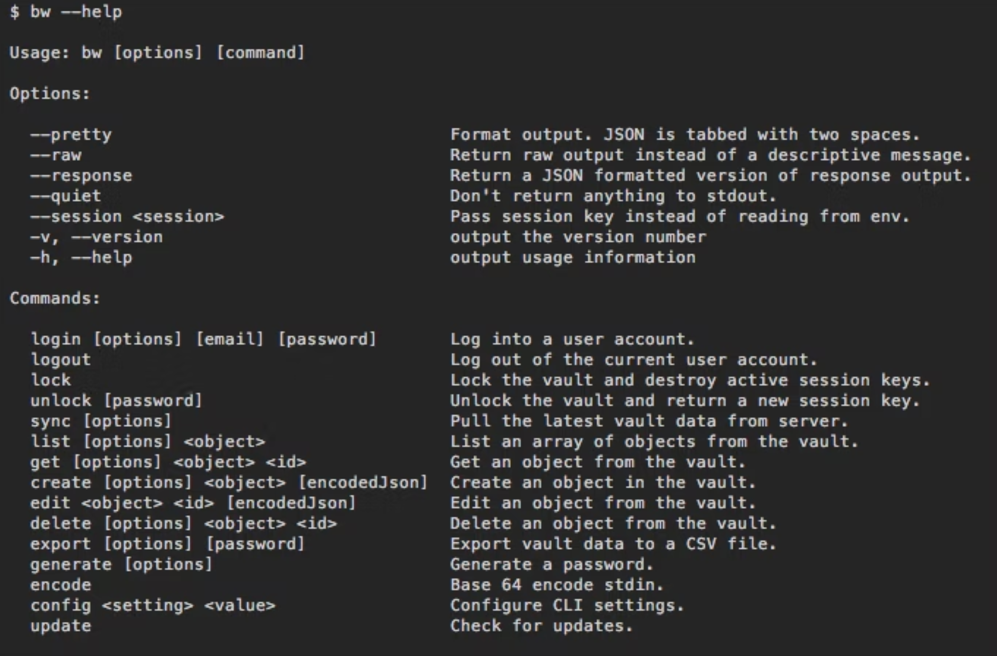
Demonstration Preview
CLI demonstration
Notes:
Oscar CLI demonstration
(NOTE that Bitwarden GUI is more common to use and intuitive)

Slide 5
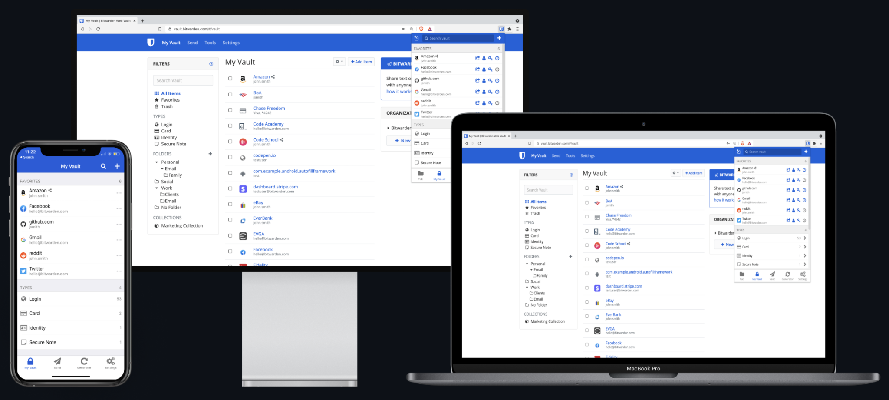
Summary
Use across all devices.
Encryption keys are confined to your devices.
Source code is published on Github for public scrutiny.
Regular Pentests conducted by third party.
Bug bounty program to reward security researchers and patch vulnerabilities.
No reported data breaches or successful cyber attacks since its inception in 2016.
End-to-end encryption would ensure the confidentiality of your stored passwords in the event of a successful cyber attack.
Notes:
Ivan- penetration test and reference links shared in Slack live channel

Slide 6

Questions
Notes:
Ivan

